Slide 1









Riesgos y beneficios de la inmunoterapia y de los ITK pre y postrasplante hepático
Alejandro Forner
Servicio de Hepatología. Unidad de Oncología Hepática. ICMDM. Hospital Clínic Barcelona. Universidad de Barcelona
@SETHepatico

Slide 2
Conflicts of interest
Consultant: AstraZeneca, Guerbert, Boston Scientific, Exact Science, SIRTEX
Conferences: Gilead, Roche, Boston Scientific
@SETHepatico

Slide 3
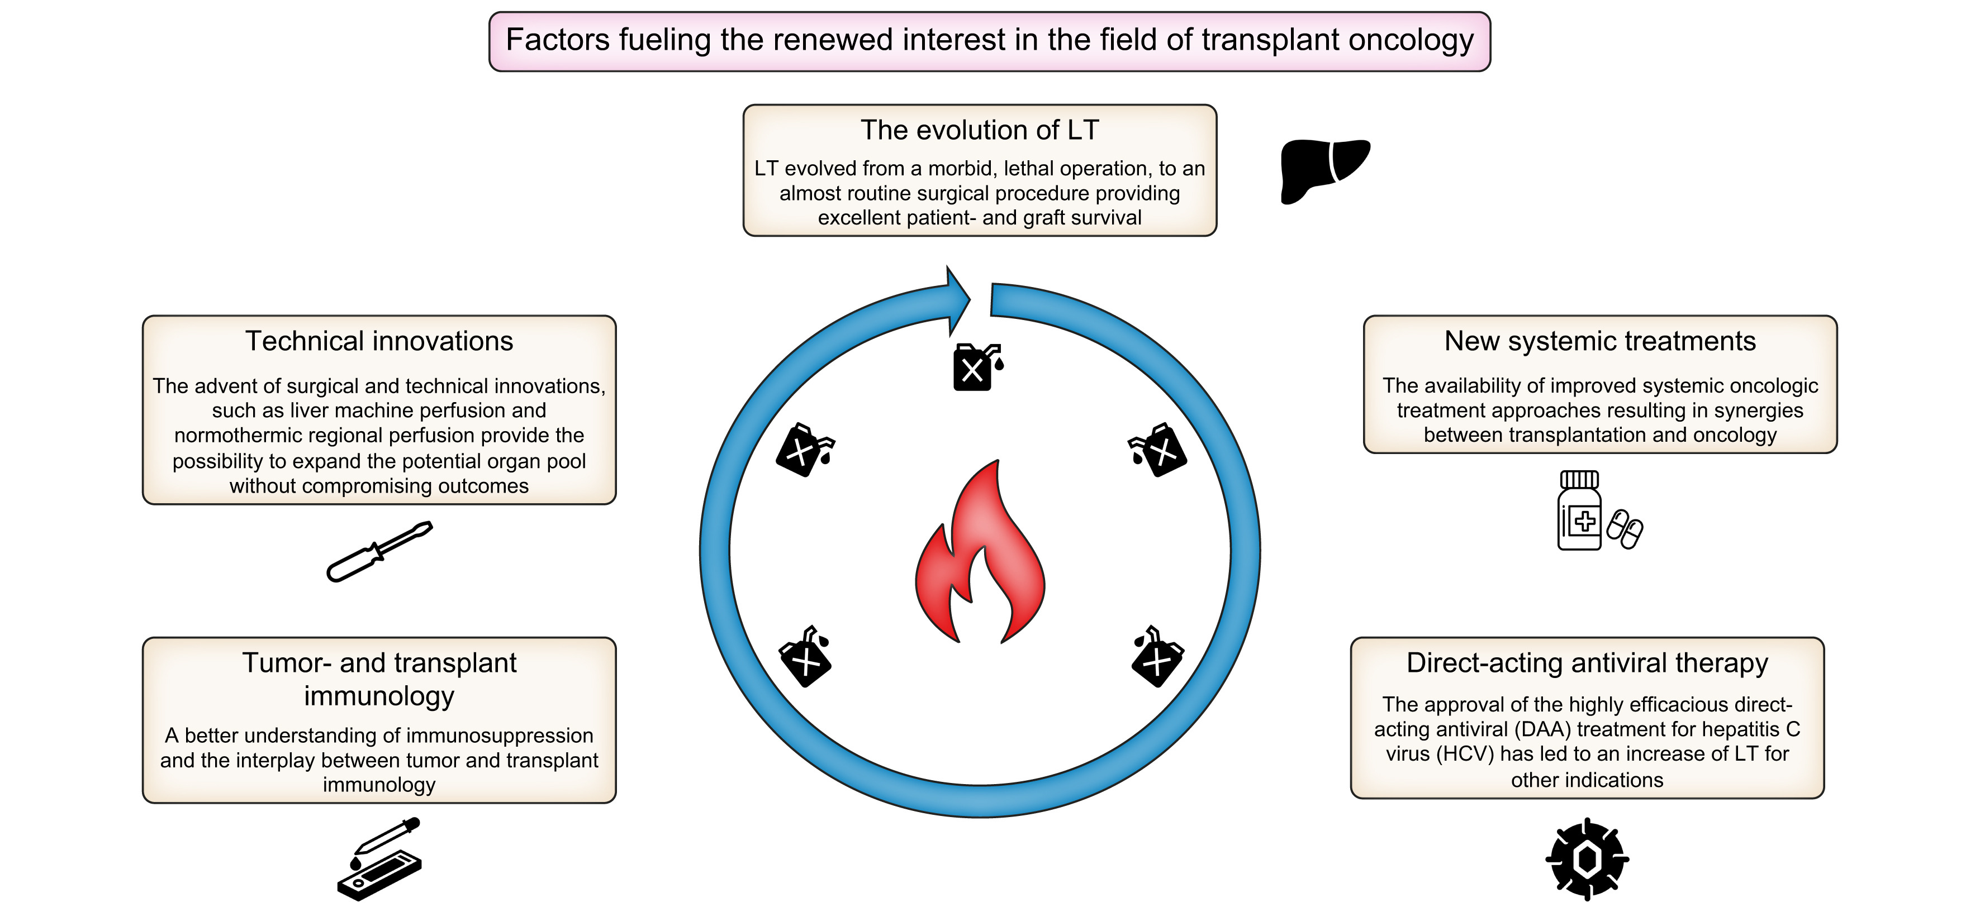
Transplant Oncology
Krendl FJ et al. JHEP Rep. 2023;6(2):100965.
@SETHepatico

Slide 4
Positive phase 3 trials in first line based on OS
Immunotherapy-based regimens
Superiority
Sorafenib
Atezolizumab-
Bevacizumab
Sintilimab-
Bevacizumab*
Tremelimumab-
Durvalumab
Carmelizumab-
Rivoceranib
Ipilimumab-
Nivolumab
v
2008
2018
2020
2021
2022
2023
2023
2025
Non-inferiority
Lenvatinib
Durvalumab
Tislelizumab⁺
v
Global trials
v
Asian Population only
HCC: Hepatocellular Carcinoma; * Biosimilar.
Llovet JM NEJM 2008, Kudo M Lancet 2018; Finn RS NEJM 2020; Ren Z Lancet Oncol 2021; Abou-Alfa NEJM Evid 2022; Qin S JAMA Oncol 2023; Qin S Lancet 2023; Galle P, Lancet 2025
@SETHepatico

Slide 5
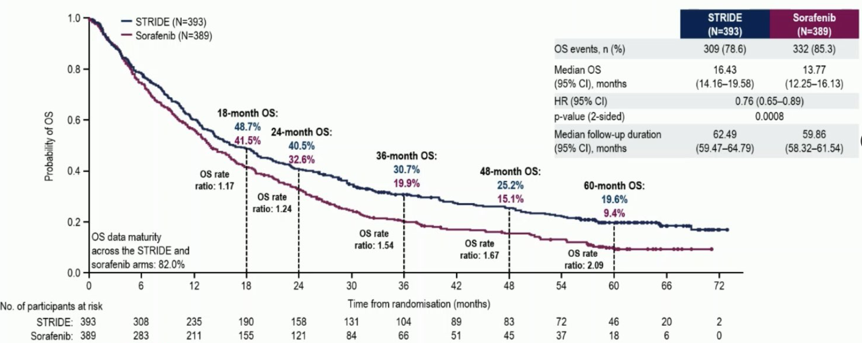
Unprecedent survivals with ICI
Atezolizumab + Bevacizumab
Tremelimumab + Durvalumab
Ipilimumab + Nivolumab
ICI: Immune Checkpoint Inhibitor
Cheng AI, et al J Hepatol 2021; Rimassa, et al J Hepatol 2025; Yau T, et al Lancet 2025
@SETHepatico

Slide 6
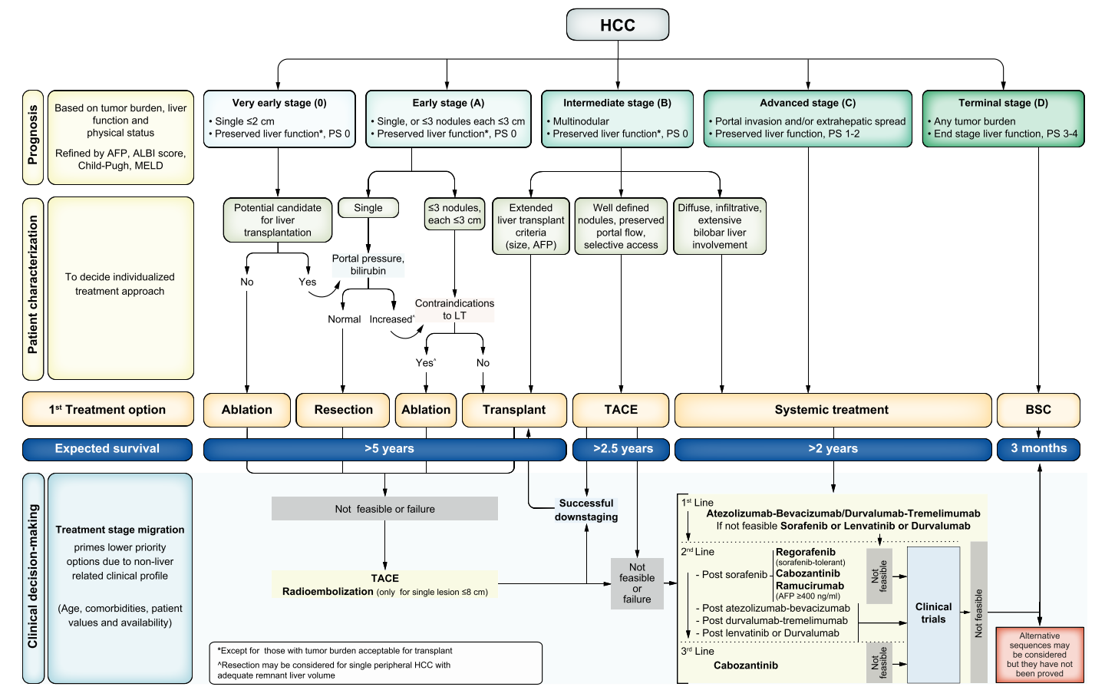
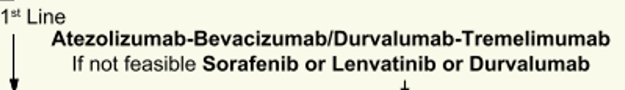
BCLC staging and treatment strategy, 2022
Reig M, Forner A, Rimola J, et al. J Hepatol. 2022 Mar;76(3):681-693.
@SETHepatico

Slide 7
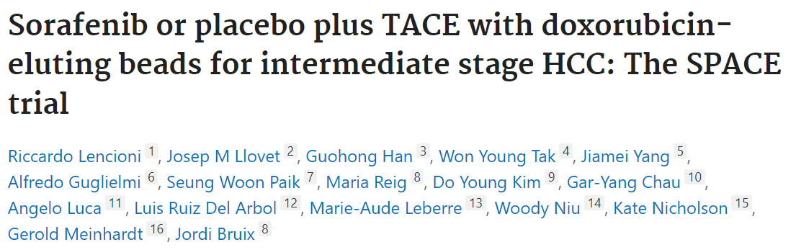
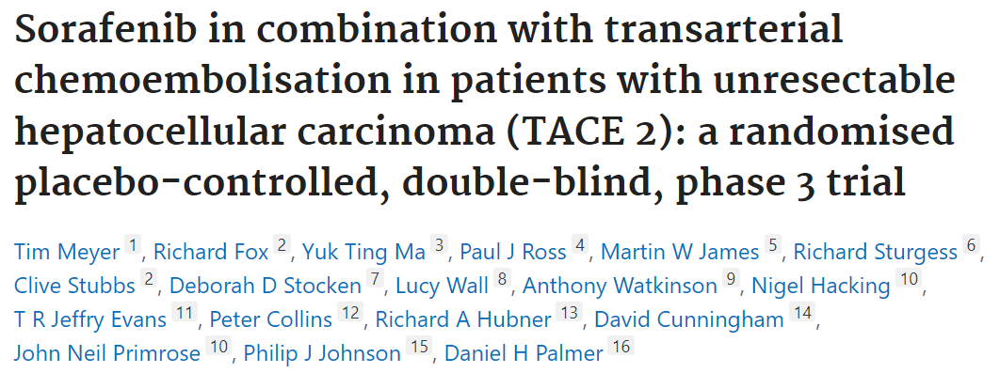
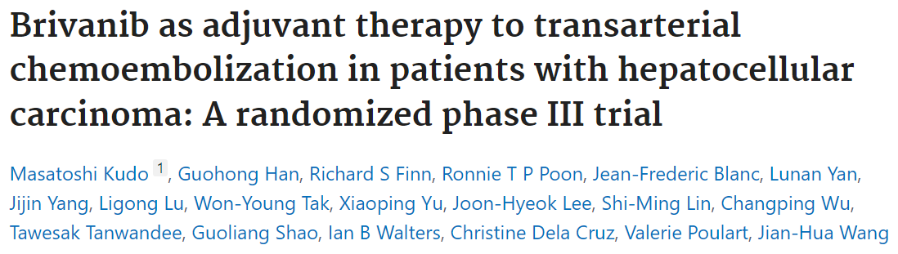
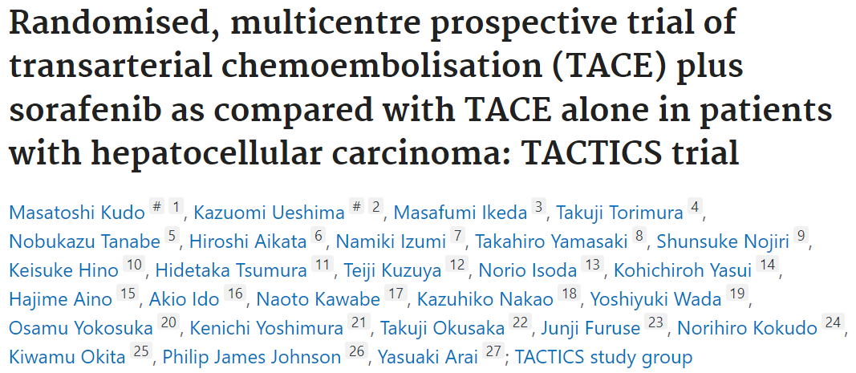
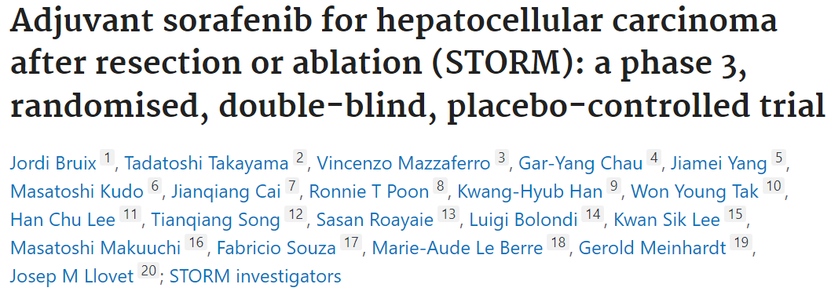
Early and Intermediate HCC: Adjuvant therapies in TKI-era
No adjuvant therapy approved in HCC!!!!
Lencioni R. et al. J Hepatol. 2016 May;64(5):1090-8.
Meyer T, et al. Lancet Gastroenterol Hepatol.; 2017;2:565–575.
Kudo M et al. Hepatology. 2014;60(5):1697-1707.
Kudo M et al. Gut. 2020 Aug;69(8):1492-1501.
Bruix J et al. Lancet Oncol. 2015 Oct;16(13):1344-54.
Uso experimental, no autorizado
@SETHepatico

Slide 8
Rate of objective response with ICI
Combination | Objective Response (RECIST v1.1), %, (95% CI) | Objective Response (mRECIST), %, (95% CI) | Duration of Response months, median (IQR)
Atezolizumab-Bevacizumab (IMbrave150) | 30 (25-35) | 33.2 (28.1–38.6) | 18.1 (4.6-NE).
Tremelimumab-Durvalumab (HIMALAYA) | 20 (NA) | NA | 22.3 (8.5-NE)
Camrelizumab- Rivoceranib (CARES-310) | 26 (20–35) | NA | 14.8 (8.4-NE)
Durvalumab (HIMALAYA) | 17 | NA | 16.8 (7.4-NE)
Tislelizumab (RATIONALE-301) | 14.3 (10.8-18.5) | NA | 36.1 (16.8 to NE)
Ipilimumab-Nivolumab (Checkmate 9DW) | 36 (31-42) | NA | 30.4 (21.2-NE)
ICI: Immune checkpoint inhibitors; CI: Confidential Interval; NA: Not Available; LT: Liver transplantation.
Finn RS, et al. N Engl J Med. 2020;382:1894–1905.
Abou-Alfa et al. NEJM Evidence 2022. DOI:https://doi.org/10.1056/EVIDoa2100070
@SETHepatico

Slide 9
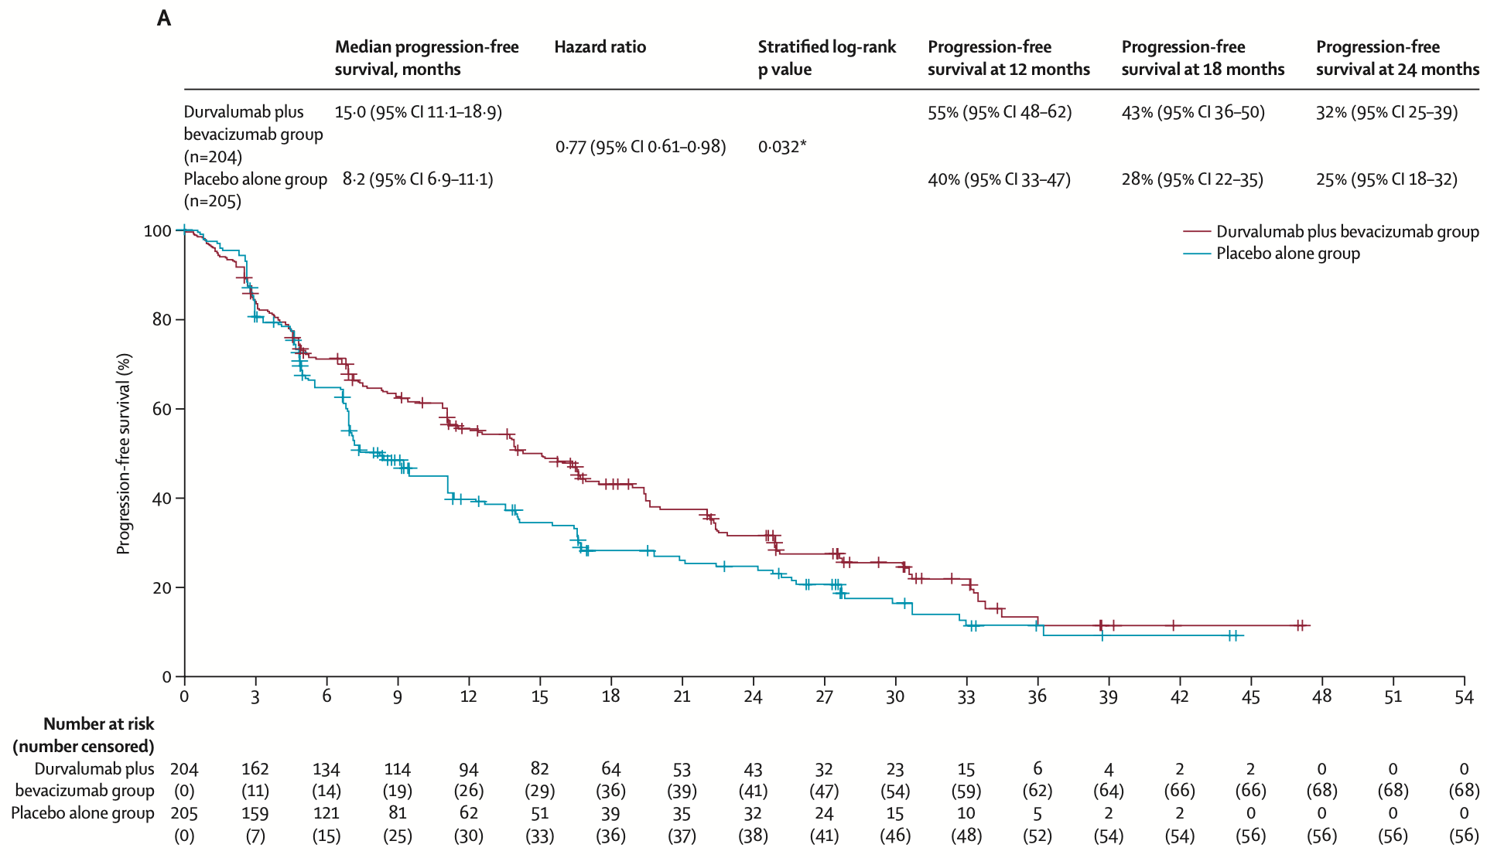
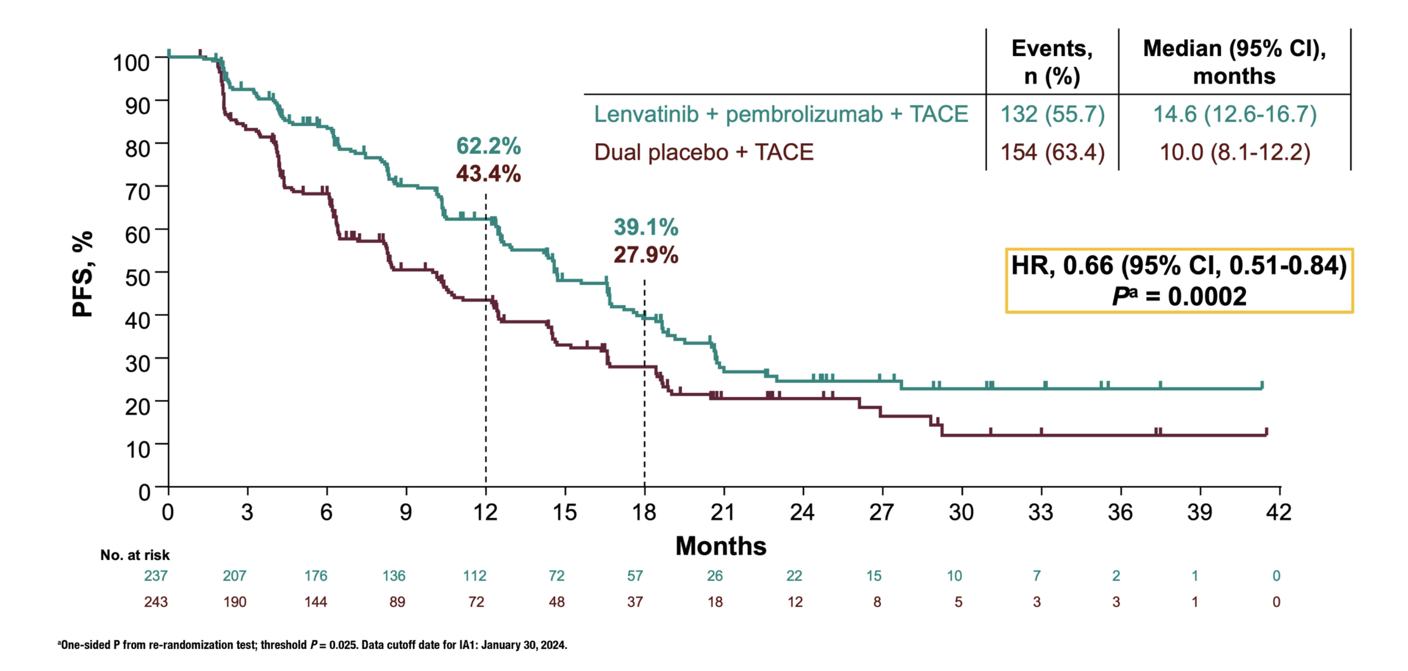
Adjuvant to TACE
EMERALD-1 and LEAP-012 trials
Expansion of ICI in the pre-LT setting: downstaging and bridging?
Sangro B et al. Lancet. 2025 Jan 18;405(10474):216-232.
Kudo M et al. Lancet. 2025 Jan 18;405(10474):203-215.
@SETHepatico

Slide 10
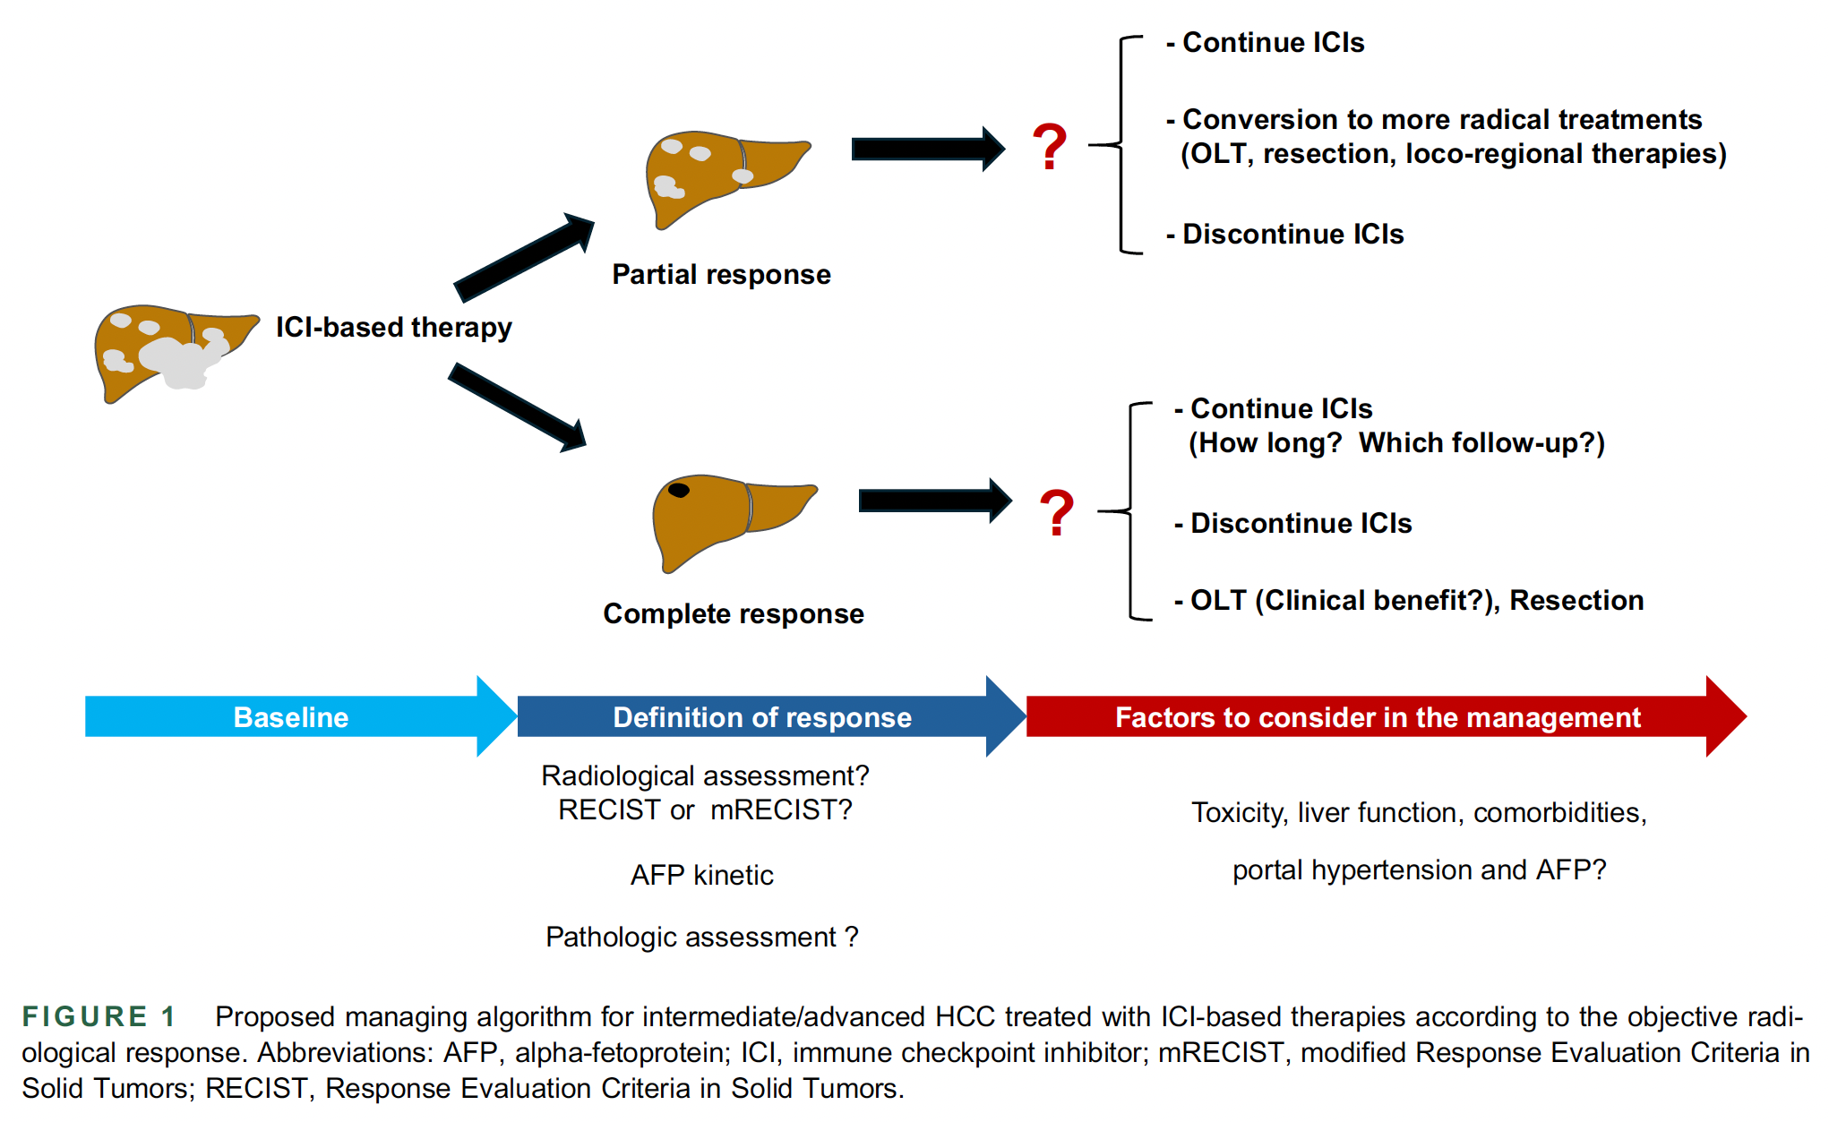
What to do after objective response?
Sanduzzi Zamparelli M and Cabibbo G, Hepatol 2024
@SETHepatico

Slide 11
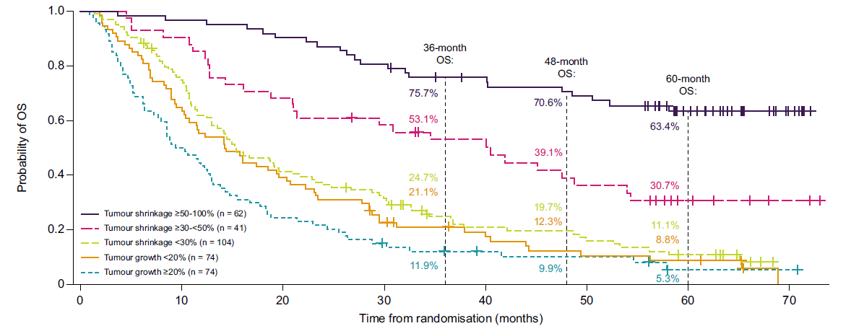
Five-year updated results: Himalaya trial
Overall survival by extent of tumour shrinkage
Disease control was defined as CR, PR or SD at the primary analysis data cut-off (27 August 2021). Extent of tumour shrinkage was based on investigator assessment. Updated OS analysis data cut-off: 01 March 2024. CR, complete response; OS, overall survival; PR, partial response; RECIST, Response Evaluation Criteria In Solid Tumors; SD, stable disease; STRIDE, Single Tremelimumab Regular Interval Durvalumab.
Rimassa L. et al. J Hepatol 2025;83:899
@SETHepatico

Slide 12
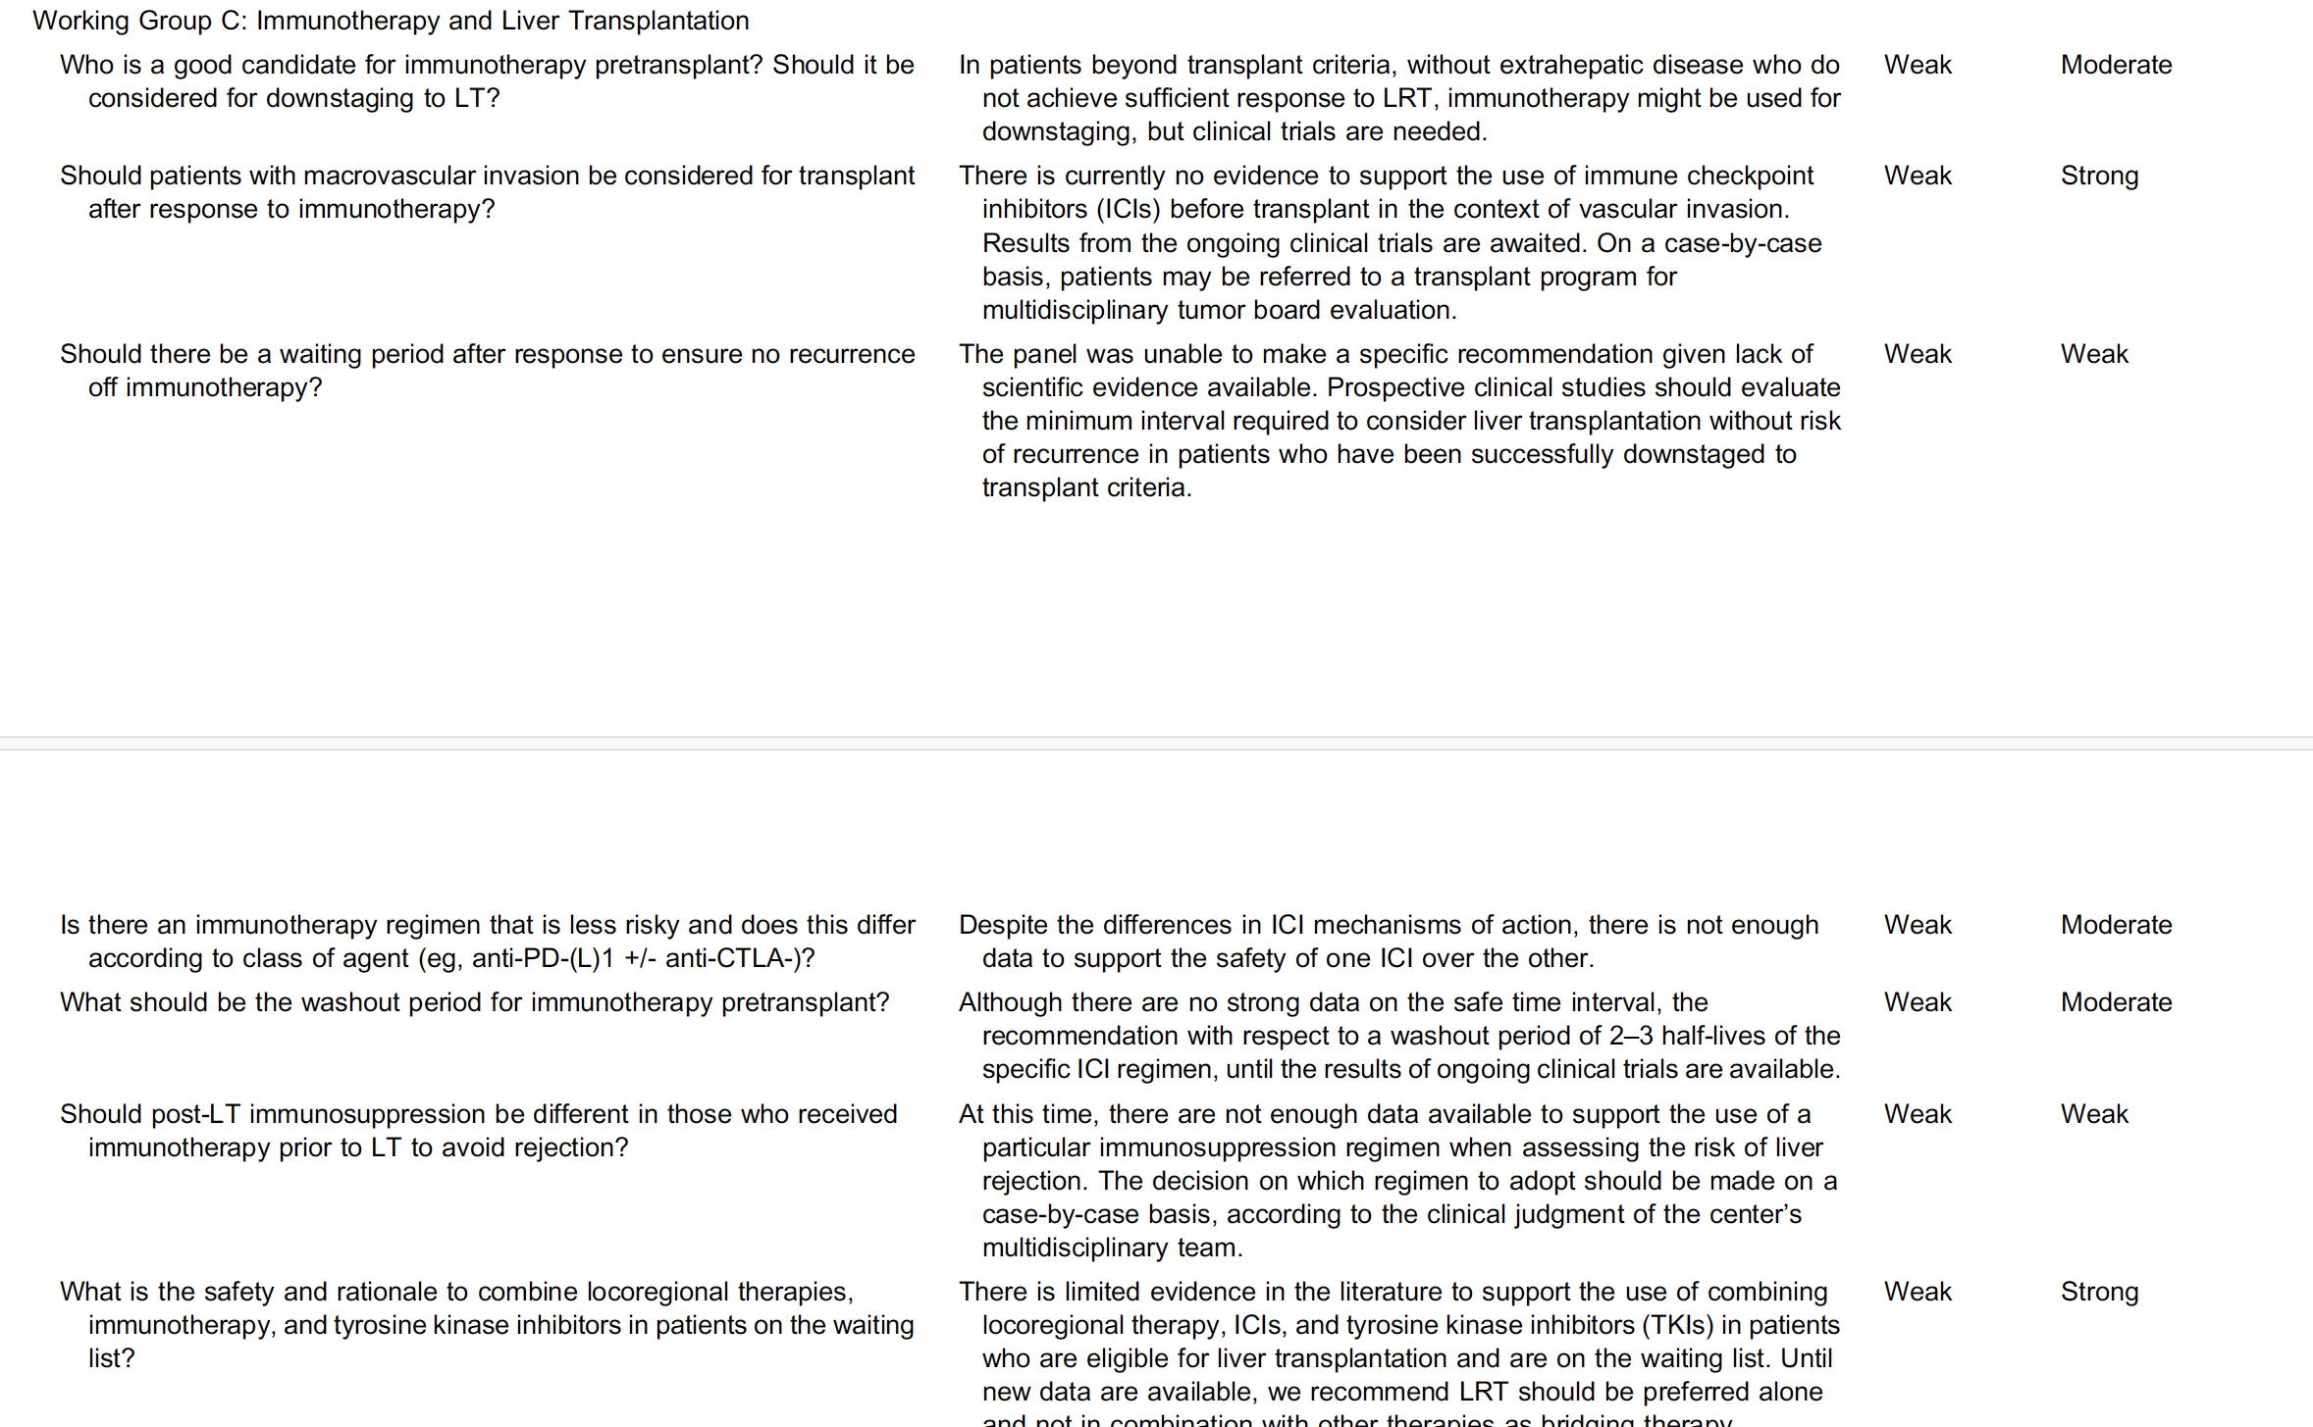
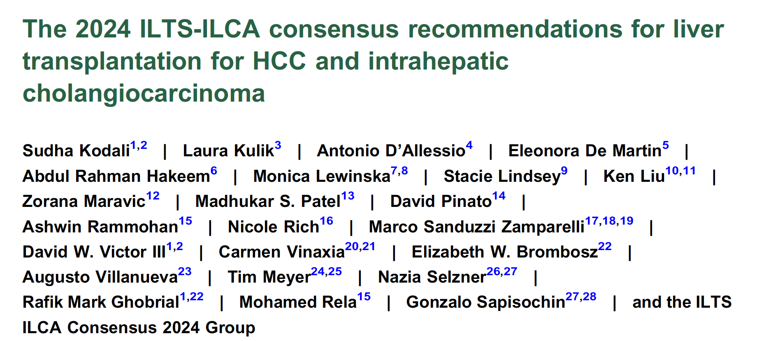
ILTS / ILCA Consensus 2024
@SETHepatico

Slide 13
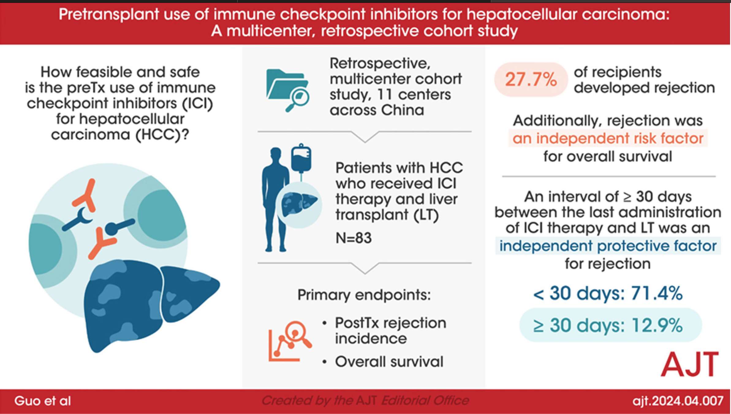
Safety of ICI before LT: retrospective studies
Is allograft rejection enough to define it is safe?
Graft loss?
Other post transplant complications? Cardiovascular? De novo tumors?
Guo et al. Am J Transplant 2024;24(10):1837-1856
@SETHepatico

Slide 14
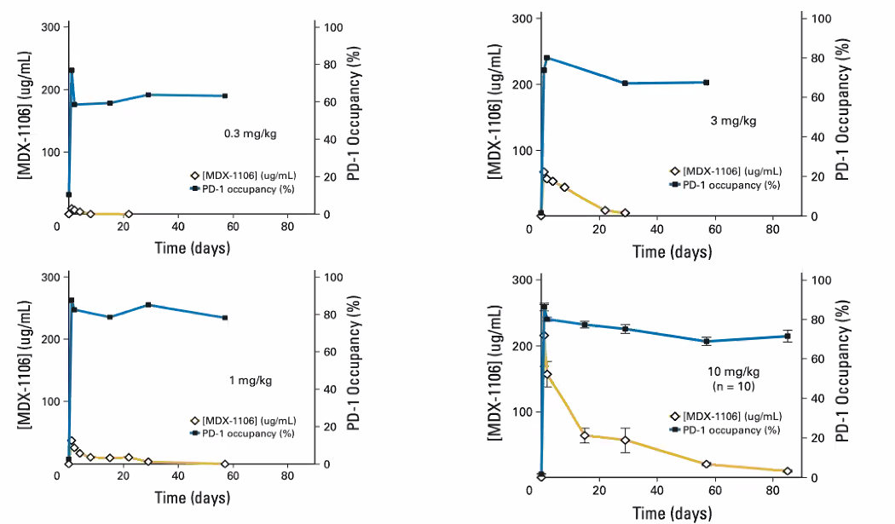
Immunotherapy pre-LT: Measuring the activity
Pharmacodynamics of anti–programmed death-1 (PD-1) monoclonal antibody (MDX-1106)
PD-1 occupancy on circulating CD3⁺ T cells
Drug | Mechanism | Half-Life
Nivolumab | PD-1 Inhibitor | 26.7 days (FDA 2014)
Pembrolizumab | PD-1 Inhibitor | 23 days (FDA 2016)
Atezolizumab | PD-L1 Inhibitor | 27 days (FDA 2018)
Durvalumab | PD-L1 Inhibitor | 18 days (FDA 2018)
Ipilimumab | CTLA-4 Inhibitor | 15.4 days (FDA 2015)
Liver transplant within one half-life (27 days) of the drug experienced acute rejection in 3/4 (75%) of cases.
6 /19 patients (32%) within 3 half-lives of nivolumab treatment.
2 /14 patients (14%) who were transplanted beyond 3 half-lives of nivolumab treatment.
Phase I trial
n= 39 pts solid tumors
Sustained mean occupancy of > 70% of PD-1 on circulating T cells ≥ 2 months following infusion, regardless of dose.
Woo SM et al Curr Oncol. 2022 13;29(12)
Brahmer JR. J Clin Oncol. 2010;28(19):3167-3175.
@SETHepatico

Slide 15
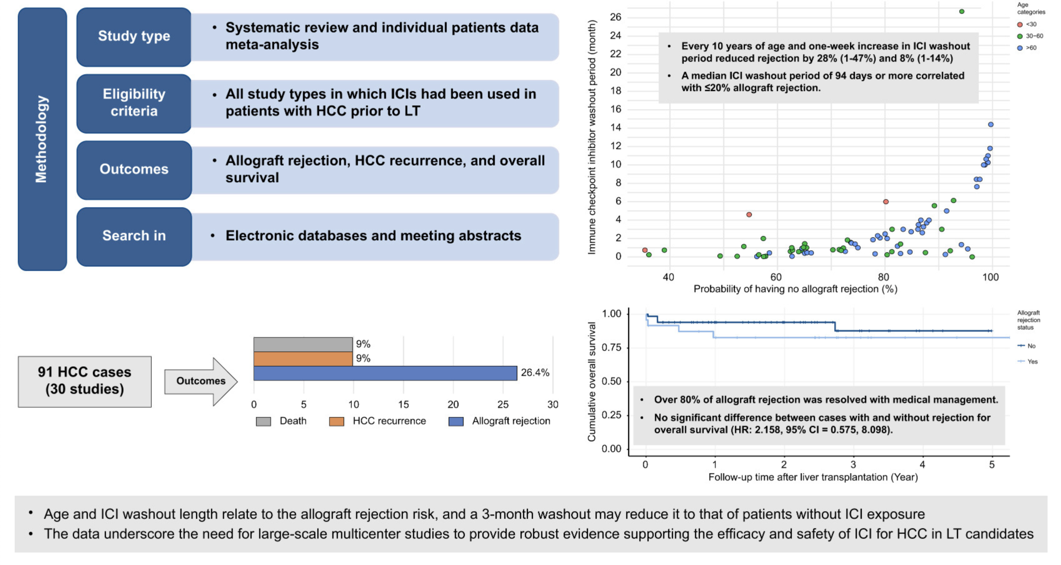
Immunotherapy and liver transplantation
Risk of rejection
Rezaee-Zavareh, MS et al. J Hepatol. 2024;82(1): 107-119
@SETHepatico

Slide 16
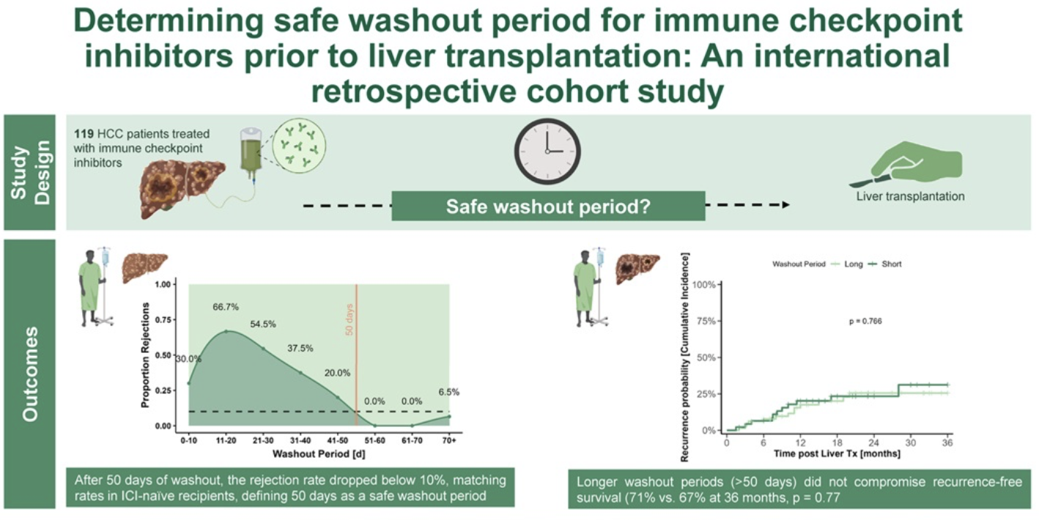
Immunotherapy and liver transplantation
Risk of rejection
Moeckli et al. Hepatology. 2025 Mar 5. doi: 10.1097/HEP.0000000000001289.
@SETHepatico

Slide 17
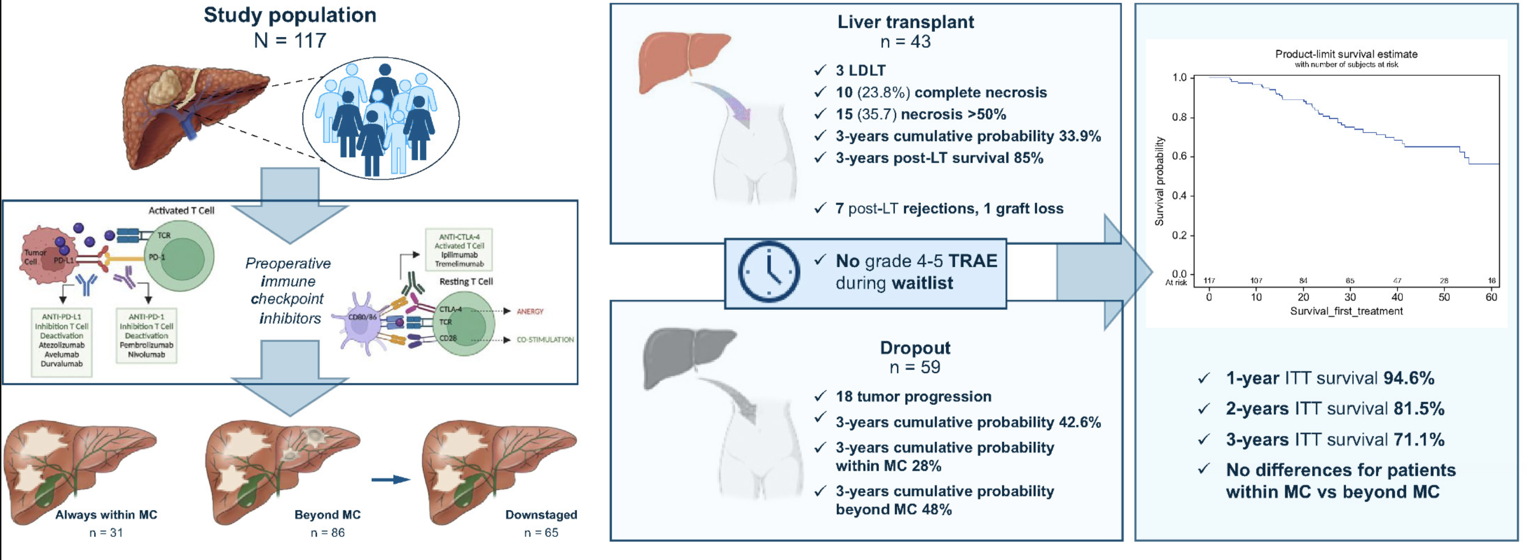
VITALIty study
Trabizian P et al. J Hepatol. 2025 Mar;82(3):512-522.
@SETHepatico

Slide 18
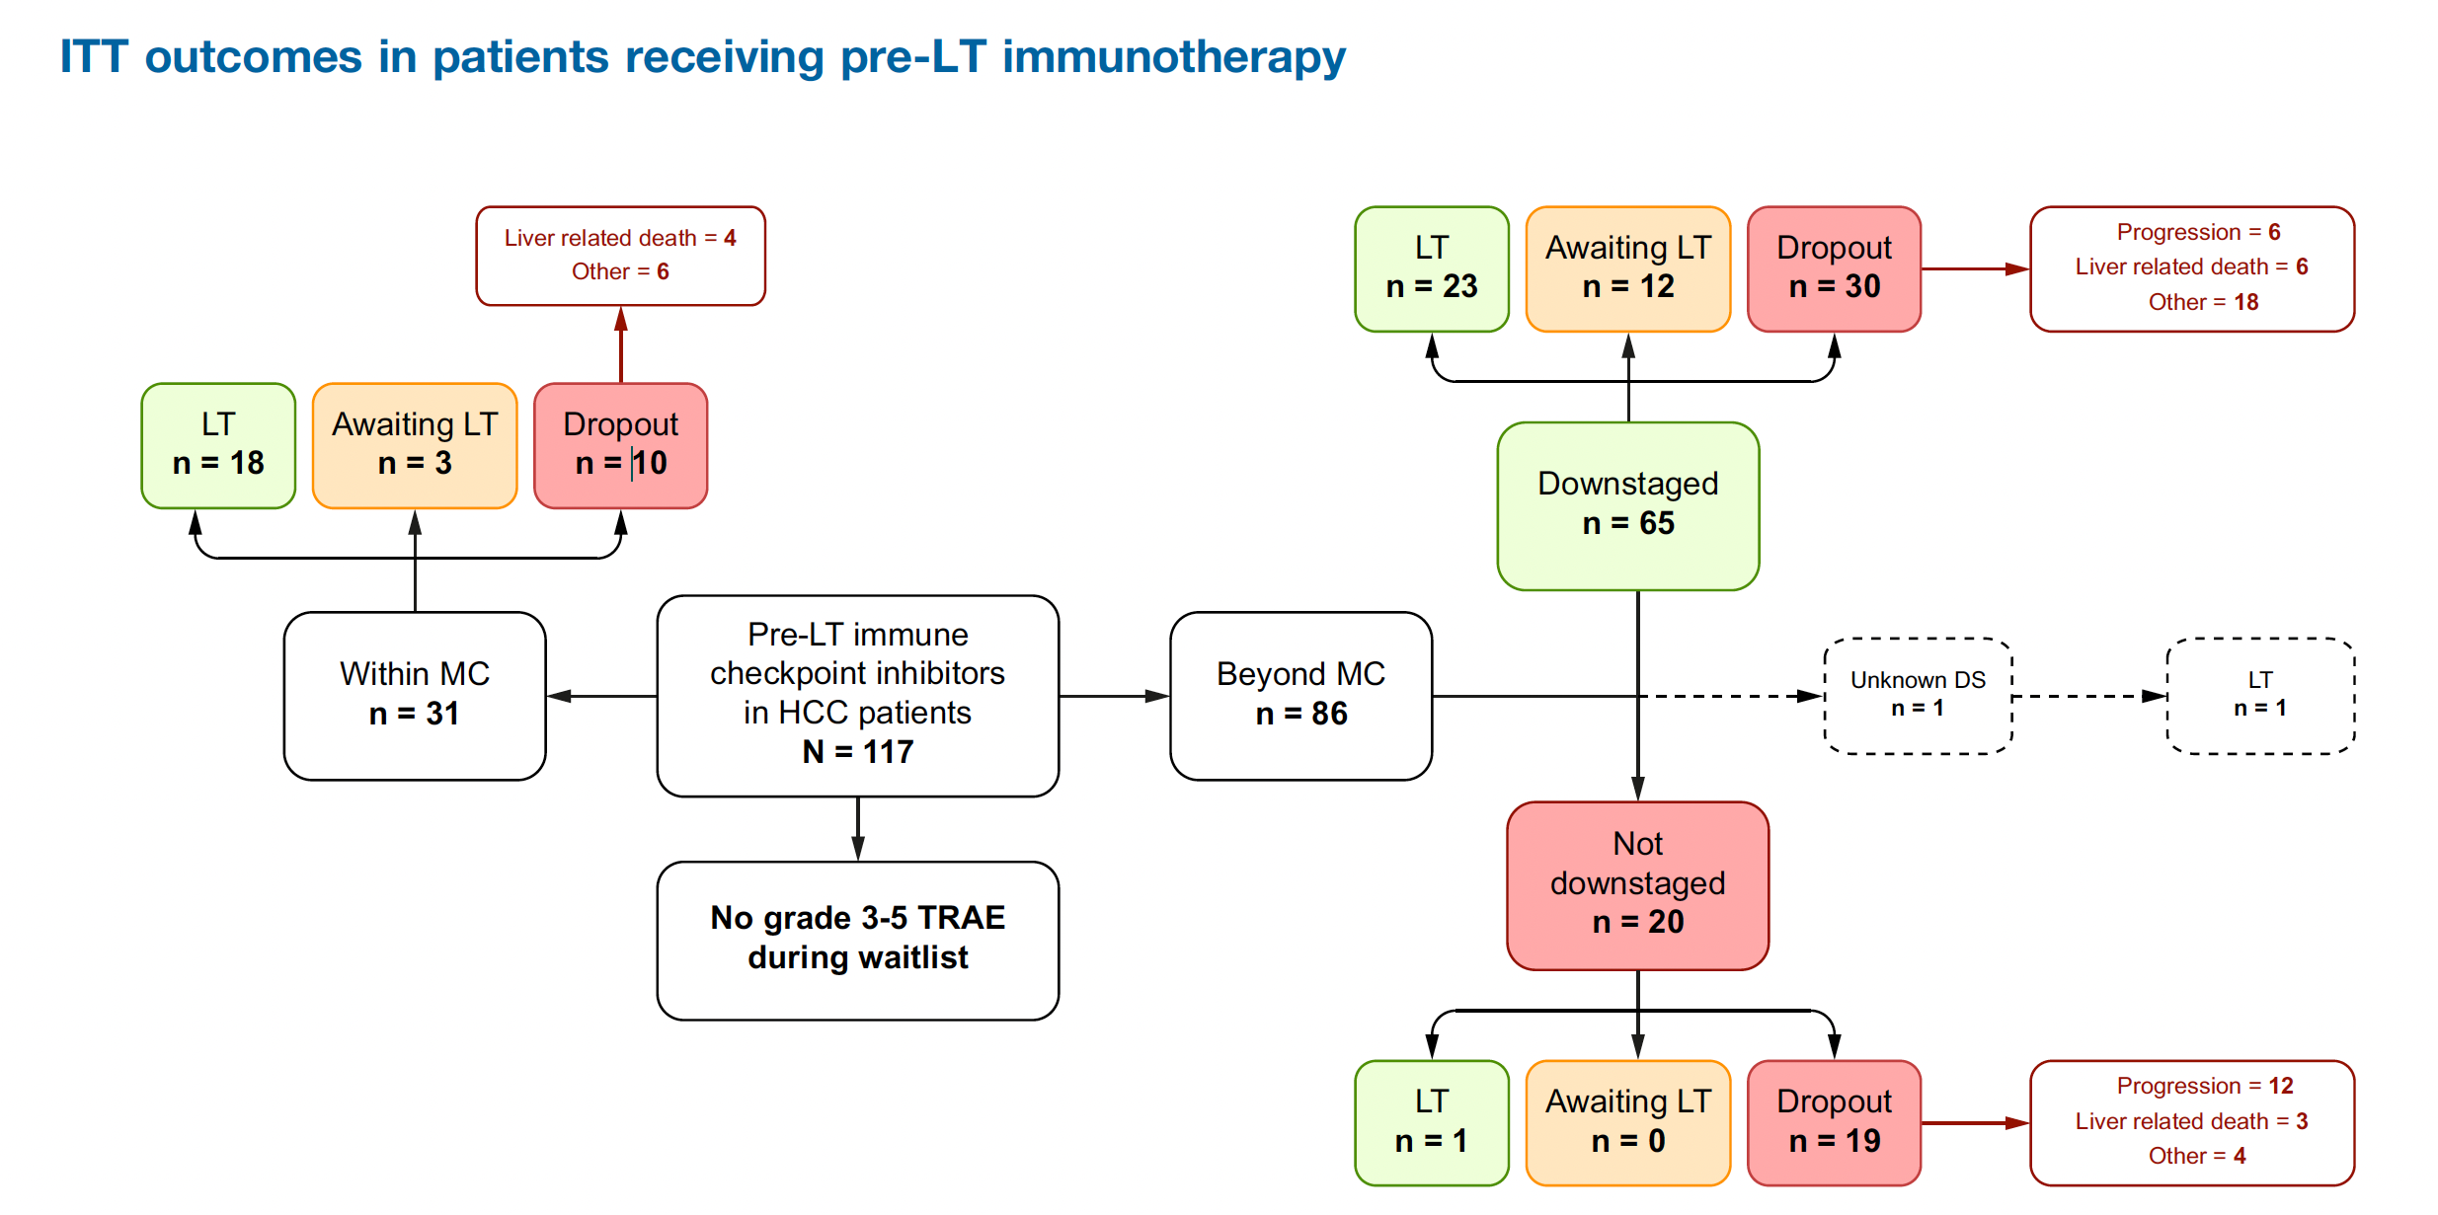
VITALIty study
43 (36%) out 117 underwent LT
59 (50.4%) experienced dropout
Downstaging in 65 out 86 (75.6%) patients ever beyond Milan Criteria
Of those down-staged, 64 (98.5%) ICI + LRT
Trabizian P et al. J Hepatol. 2025 Mar;82(3):512-522.
@SETHepatico

Slide 19
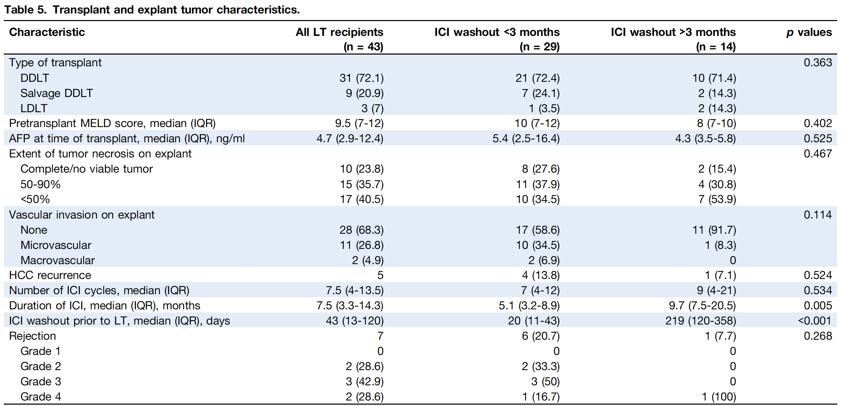
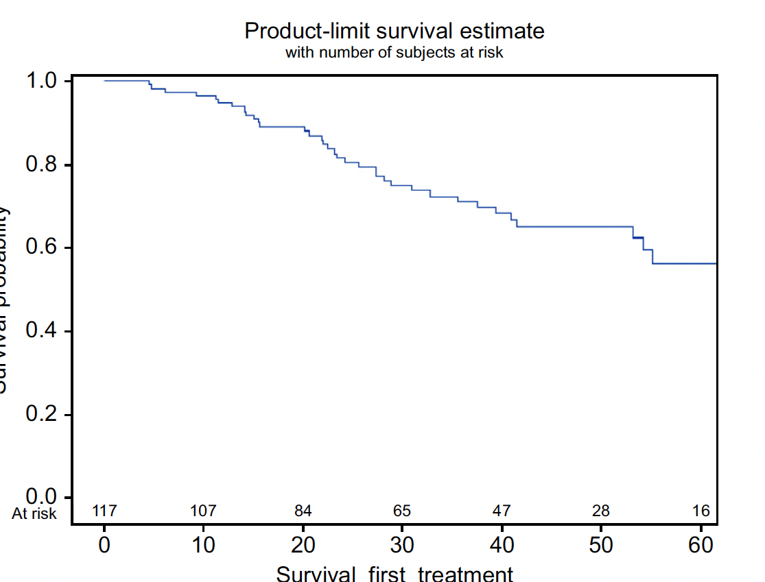
VITALIty study
ITT OS:
1 year 94.6%
2 year 81.5%
3 year 71.1 %
7 out 43 (16%) experienced liver rejection
1 graft loss (2.3%)
Trabizian P et al. J Hepatol. 2025 Mar;82(3):512-522.
@SETHepatico

Slide 20
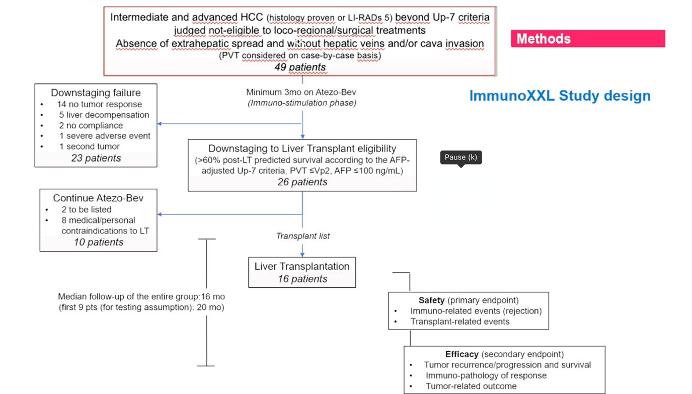
Immune XXL trial
Bhoori S, et al. J Hepatol 2024;80: S70.
@SETHepatico

Slide 21
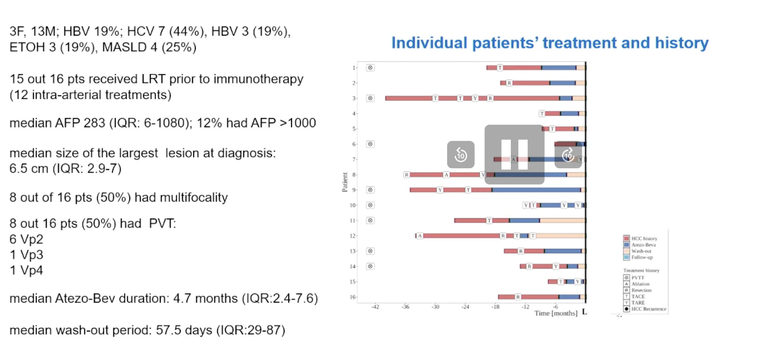
Immune XXL trial
Bhoori S, et al. J Hepatol 2024;80: S70.
Bhoori S, et al. J Hepatol 2024;80: S70.
@SETHepatico

Slide 22
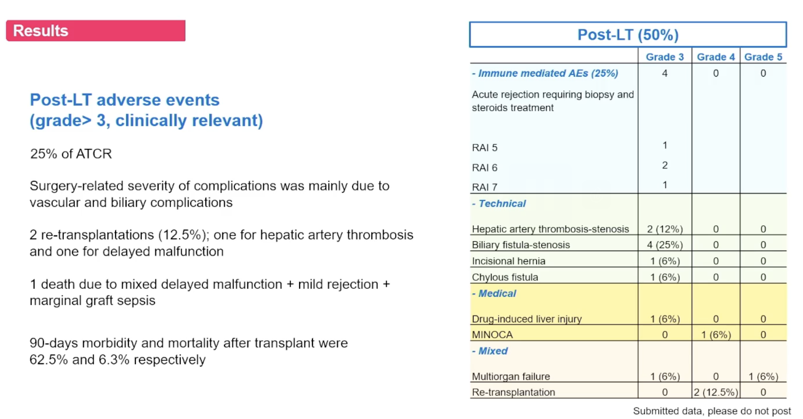
Immune XXL trial
Bhoori S, et al. J Hepatol 2024;80: S70.
@SETHepatico

Slide 23
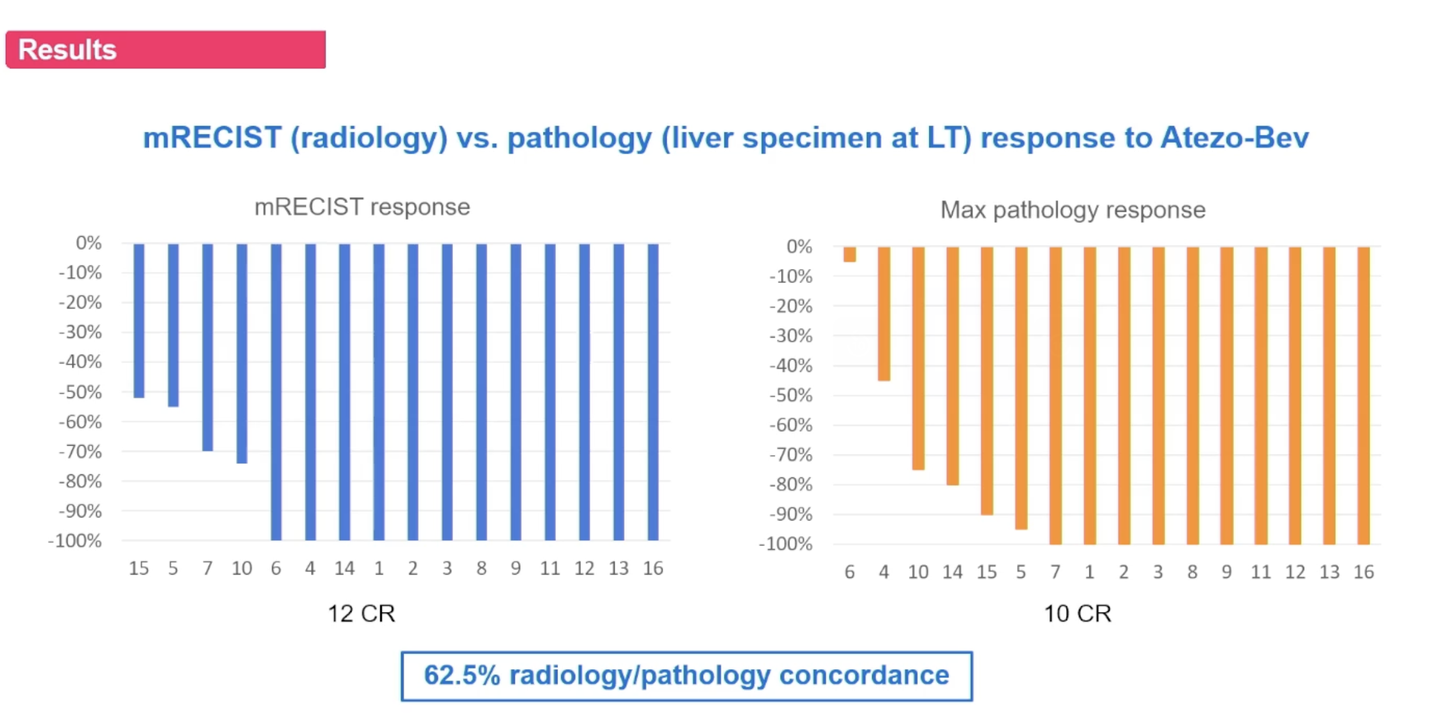
Immune XXL trial
Bhoori S, et al. J Hepatol 2024;80: S70.
@SETHepatico

Slide 24
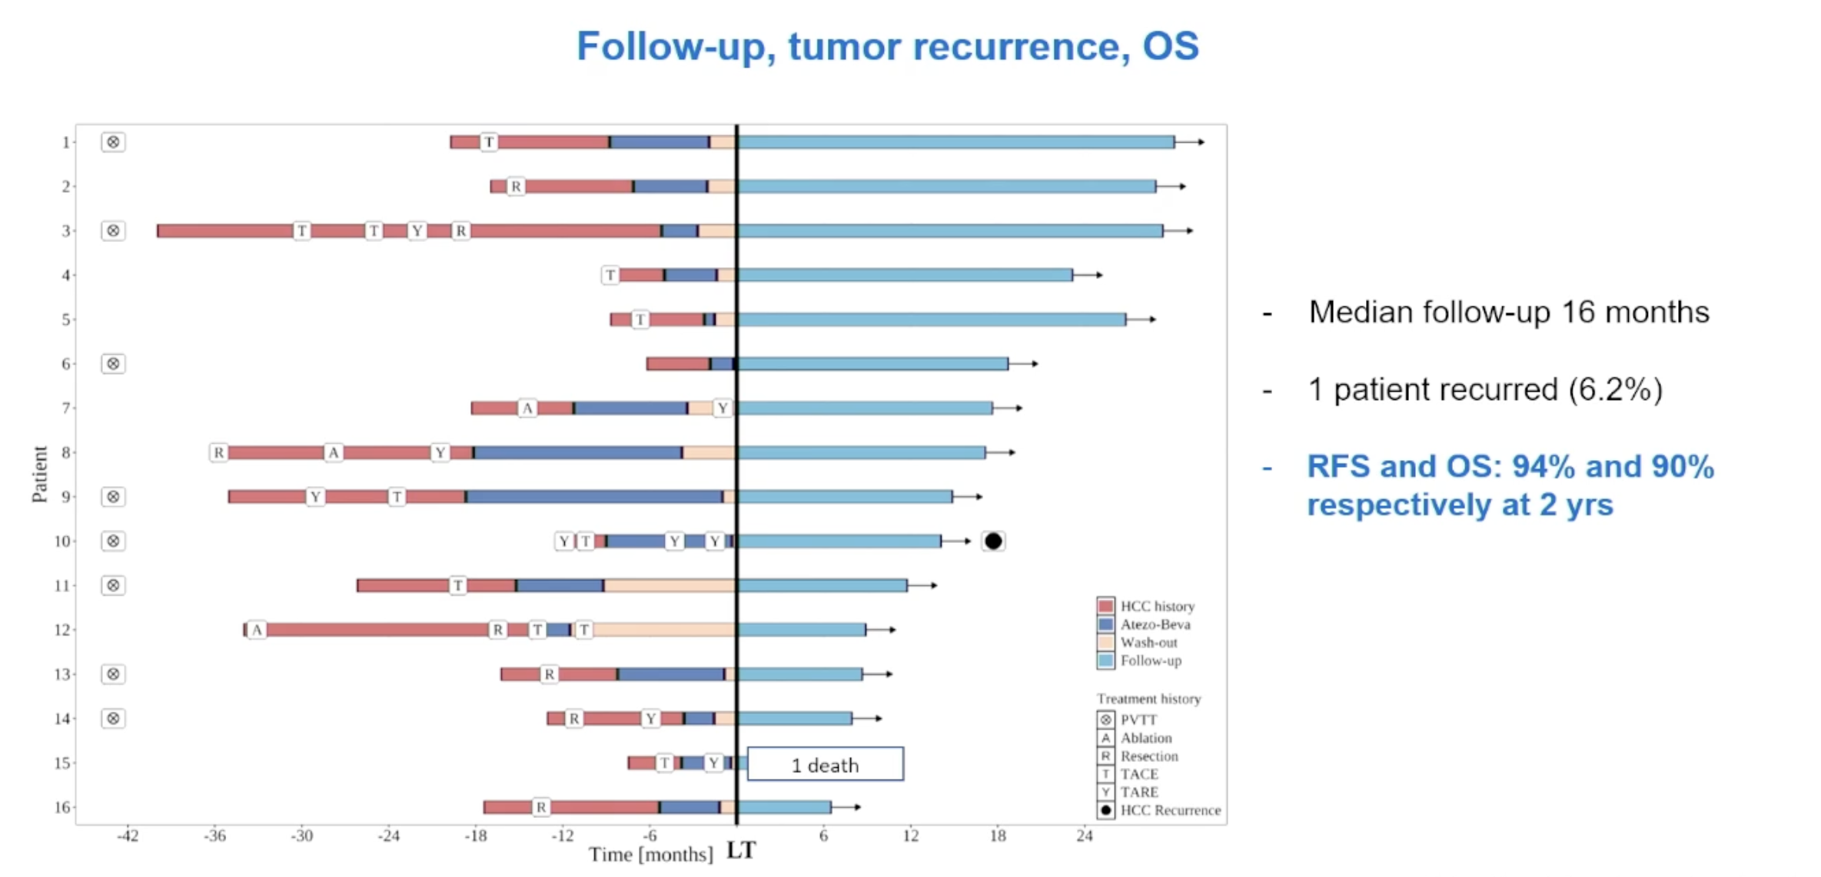
Immune XXL trial
Bhoori S, et al. J Hepatol 2024;80: S70.
@SETHepatico

Slide 25
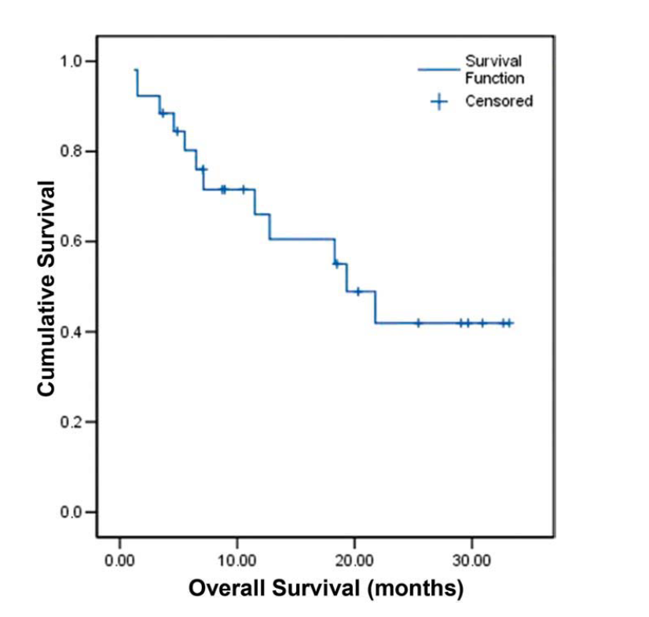
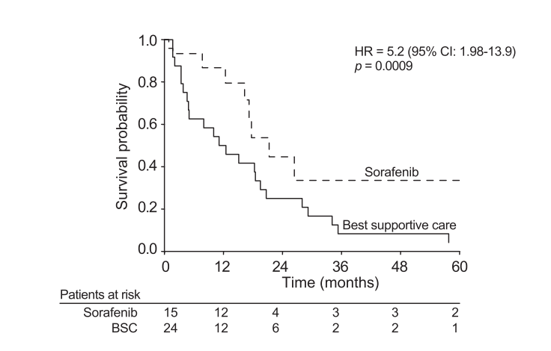
Therapy of HCC recurrence after Liver transplantation
Systemic therapy with sorafenib (and mTOR)
N=31
The median OS was 19.3 months [95%CI: 13.4–25.1], and the median TTP was 6.77 months (95% CI: 2.3–11.1).
Gomez-Martin C,et al. Liver Transplant. 2012;18:45–52.
Sposito C, et al. J Hepatol. 2013;59:59–66.
@SETHepatico

Slide 26
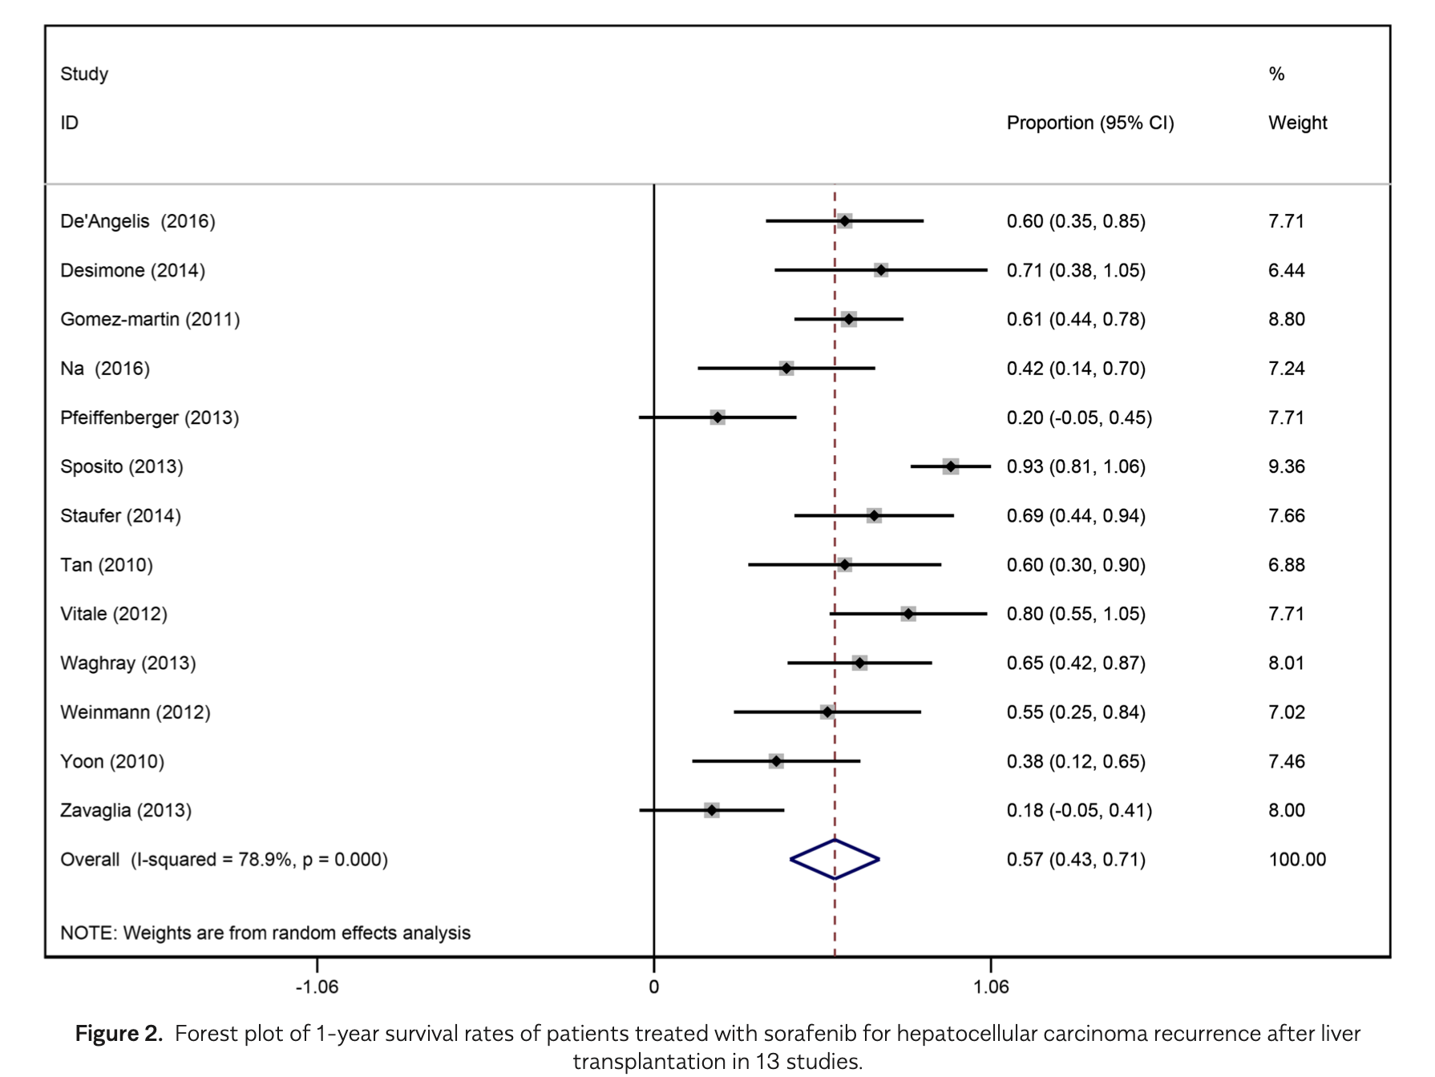
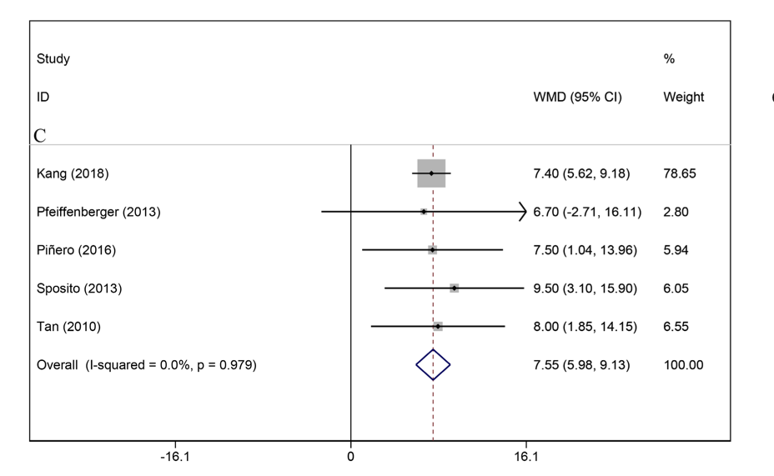
Therapy of HCC recurrence after Liver transplantation
Systemic therapy with sorafenib (and mTOR)
Li et al. Turk J Gastroenterol. 2021 Jan;32(1):30-41
@SETHepatico

Slide 27
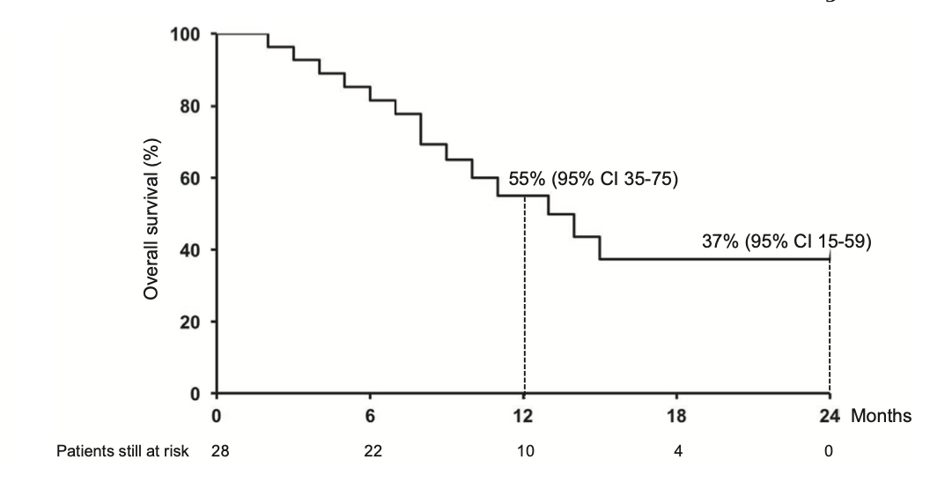
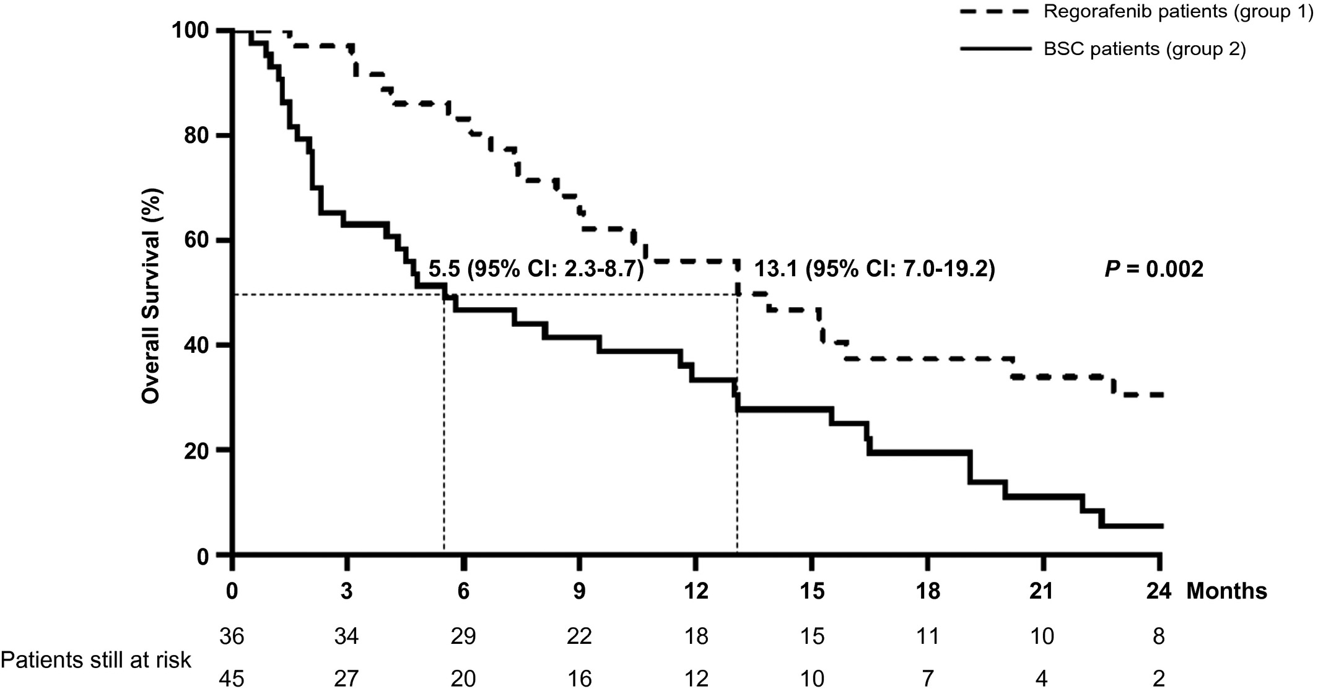
Therapy of HCC recurrence after Liver transplantation
Systemic therapy with regorafenib
The median OS was 12.9 months (95% CI, 6.7‐19.1)
The median OS was 13.1 (versus 5.5 months; P < 0.01)
The use of Regorafenib had a HR, 0.37; ( CI95%, 0.16-0.89; P = 0.02).
The median OS calculated from sorafenib start was 28.8 months (95% CI, 17.6-40.1) in group 1 versus 15.3 months (95% CI, 8.8-21.7) in group 2 (P < 0.01)
Iavaronne M et al. Am J Transplant. 2019 Nov;19(11):3176-3184.
Iavaronne M et al. Liver Transpl. 2021 Dec;27(12):1767-1778.

Slide 28
Allograft rejection in liver transplant recipientes treated with ICI
Allograft rejection in liver transplant recipientes treated with ICI: case series with > 3 patients
N of LT recipientes who developed acute rejection | Organ failure after acute rejection | Reference
4/11 (36%) | 3 /4 (75%) | Gassmann, Transpl Direct 2018
9/24 (37.5%) | 6 / 8 (75%) | D´Izarny-Gargas, Am J Tranaspl 2020
7/19 (39%) | Non-reported | Kumar, The Oncologist 2020
2/8 (25%) | 0 | Owoyemi, Cancer 2020
7/20 (35%) | 6/7 (86%) | Fisher, J Am Acad Dermatol, 2020
The average time to graft rejection from first ICI use was 3 weeks;
Most graft rejection after ICI therapy occurred in patients who had transplant within 3 years;
ICI: Immune checkpoint inhibitors; LT: liver tranasplant
Luo Y et al. World J Gastrointest Oncol 2022; 14(1): 163-180
@SETHepatico

Slide 29
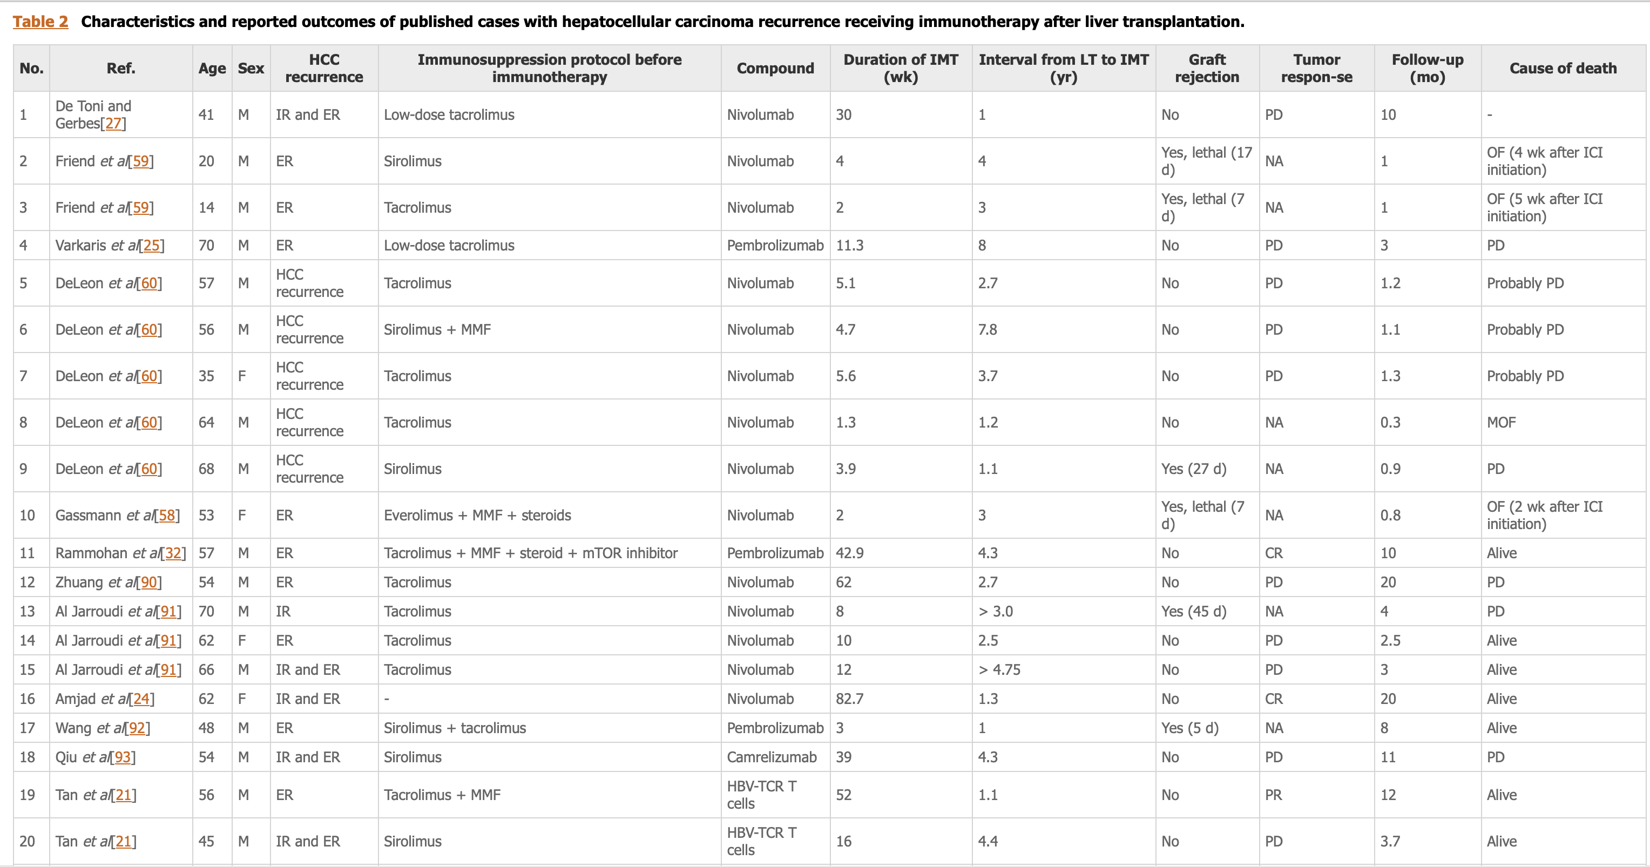
Outcomes of postLT rrecurrent patients receiving Immunotherapy
ICI: Immune checkpoint inhibitors; LT: liver tranasplant
Luo Y et al. World J Gastrointest Oncol 2022; 14(1): 163-180
@SETHepatico

Slide 30
Risks and benefits of TKIs and ICIs in the pre- and post-LT
Take home messages
The application of transplant oncology should be done if the local dynamics of the waiting list does not harm the other included patients (both the HCC patients and those with advanced liver disease)
Urgent need to define homogeneous criteria for downstaging
The use of TKIs pre-LT is not supported. However, TKIs are safe in post-LT setting. The use of ICIs post-LT is associated with high risk of acute rejection
Future challenges:
Assess the risk of rejection and strategies for prevention
Evaluate the real benefit of LT in those with CR (or deep response) after ICI
@SETHepatico

Slide 31


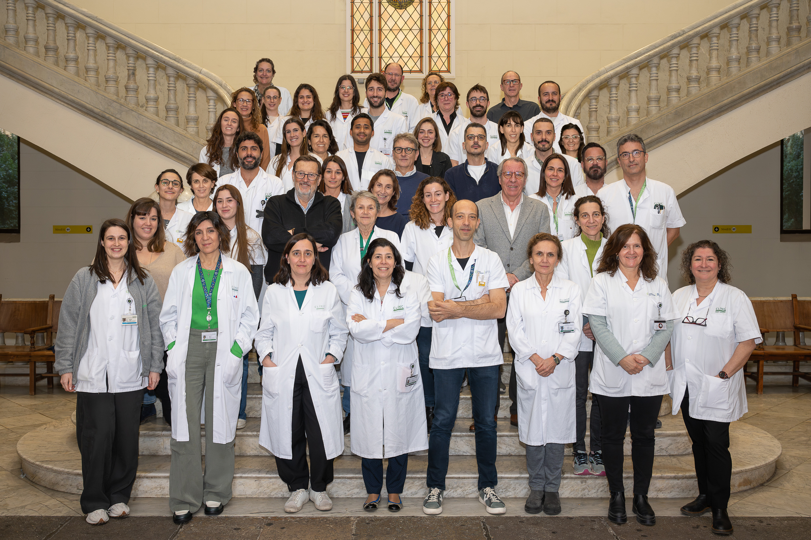

The BCLC group

